Slide 1
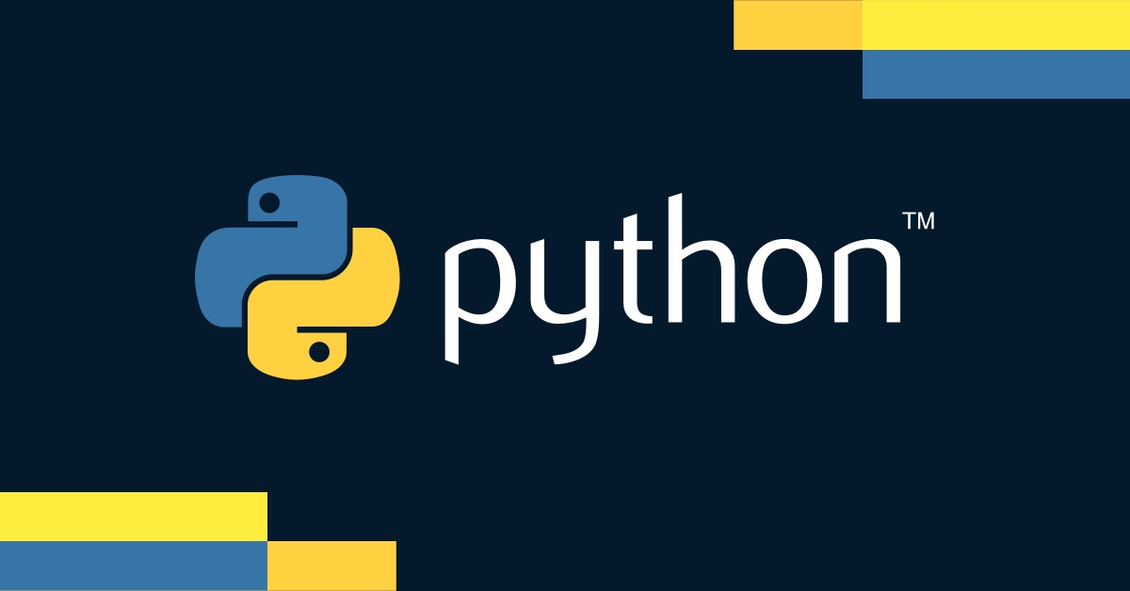

Slide 3
Creating a Django App
Definition
Web application that does something – e.g., a blog system, a database of public records, or a small business website
Command
Create an app within your project with the command
python manage.py startapp myapp

Slide 4
Creating a Django App
App Structure
models.py
Define your data models
views.py
Handle the request/response logic
urls.py
Map URLs to views
admin.py
Register models for the admin interface
apps.py
App configuration
migrations/
Database migrations folder
templates/
HTML templates for your app
static/
Static files such as CSS and JavaScript

Slide 5
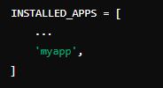
Configuring the App
Registering the App
Add the new app to INSTALLED_APPS in settings.py
Example
Database Migrations
Create initial database tables for the new app
Commands
python manage.py makemigrations myapp
Create migration scripts
python manage.py migrate
Apply migrations to the database

Slide 6
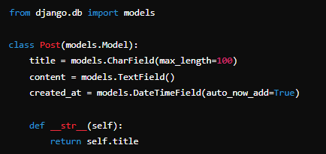
Defining Models
Model Basics
Models are Python classes that represent database tables
Each model class variable represents a database field
Example
Explanation
title
A CharField for the post title
content
A TextField for the post content
created_at
A DateTimeField automatically set to the current date and time when the post is created

Slide 7
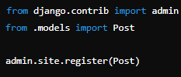
Admin Interface
Purpose
The Django admin interface allows for easy management of the site’s data
Registering Models
Register your models in admin.py so they appear in the admin interface
Example
Creating an Admin User
Create a superuser account with python manage.py createsuperuser.
Provide a username, email, and password as prompted
Accessing Admin Interface
Navigate to http://127.0.0.1:8000/admin/
Log in with the superuser credentials to access and manage the data

Slide 8
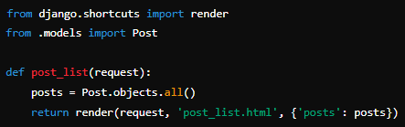
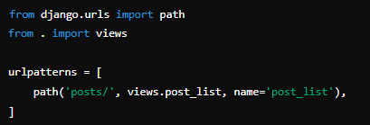
Views and URLs
View Basics
Views are Python functions or classes that handle requests and return responses.
A view retrieves data from the model, processes it, and passes it to the template
Example View
URL Configuration
Map views to URLs in urls.py
Example URL Mapping

Slide 9

What command is used to start a new Django project?
django-admin startproject projectname
How do you create a new Django app within a project?
python manage.py startapp appname
Which file contains the project settings, including installed apps and database configuration?
settings.py
What is the purpose of the urls.py file in a Django project?
To define URL patterns that route requests to views
How do you run the Django development server?
python manage.py runserver
What is the Django ORM used for?
To interact with the database using Python code instead of SQL queries

